Slide 1
Binary Search Trees

Slide 2
Binary Search Tree (BST)
The left subtree of a node contains only nodes with keys less than the node's key.
The right subtree of a node contains only nodes with keys greater than the node's key.
The left and right subtree each must also be a binary search tree.
There must be no duplicate nodes.

Slide 3
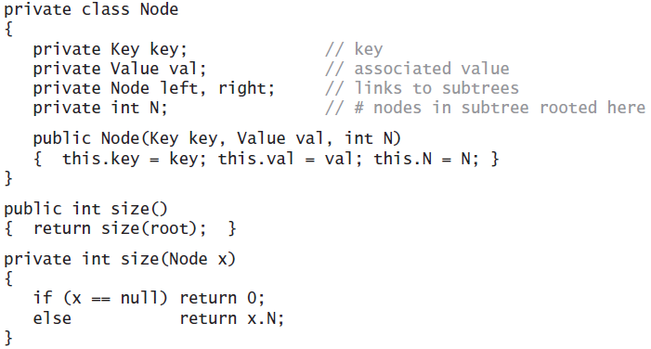

Slide 4
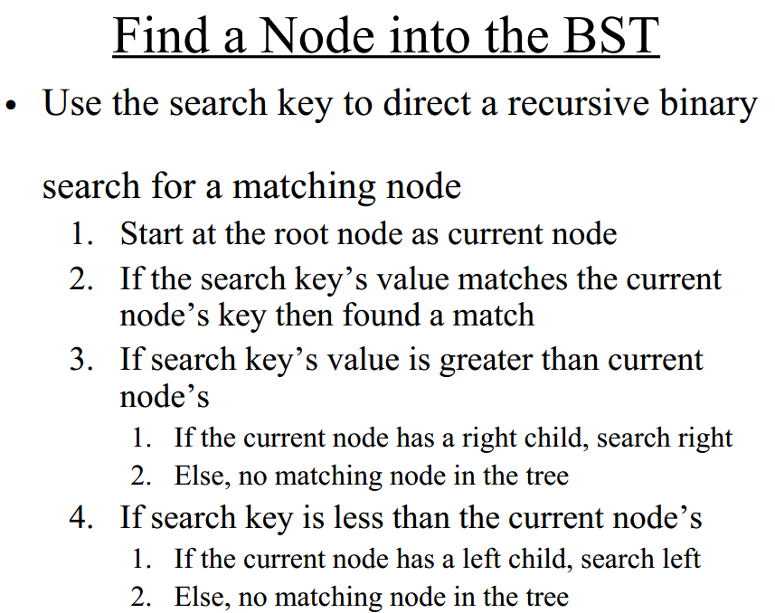

Slide 5
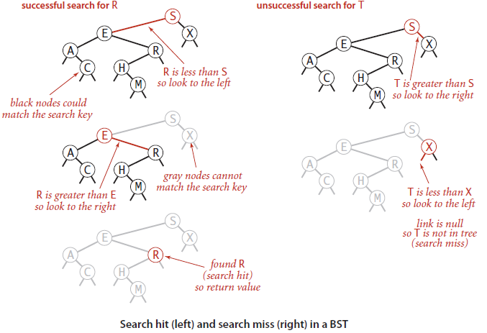

Slide 6
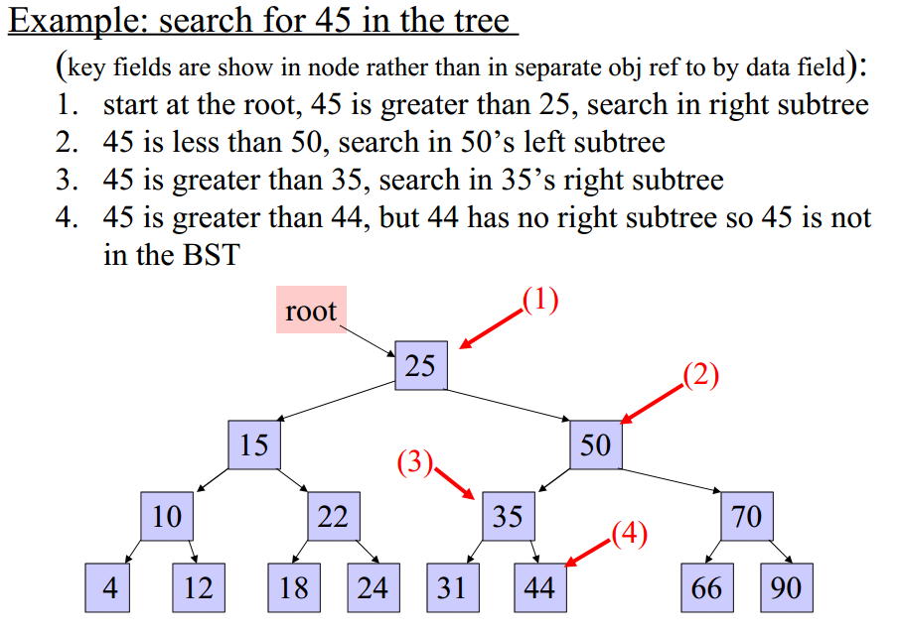

Slide 7
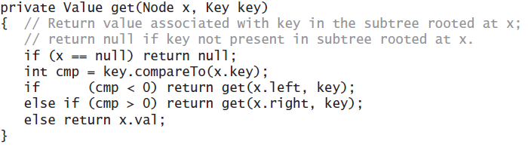

Slide 8
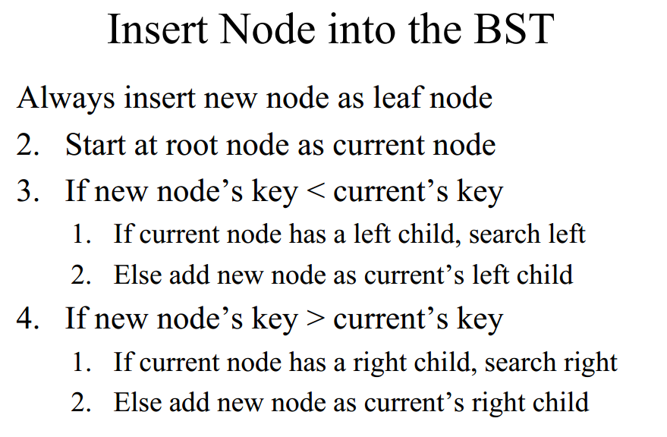

Slide 9
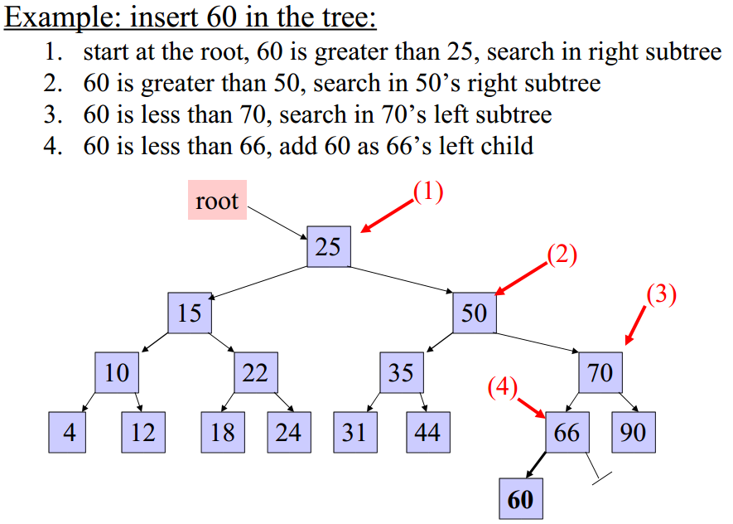

Slide 10
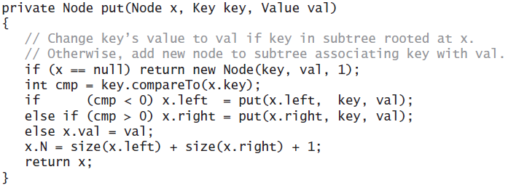

Slide 11
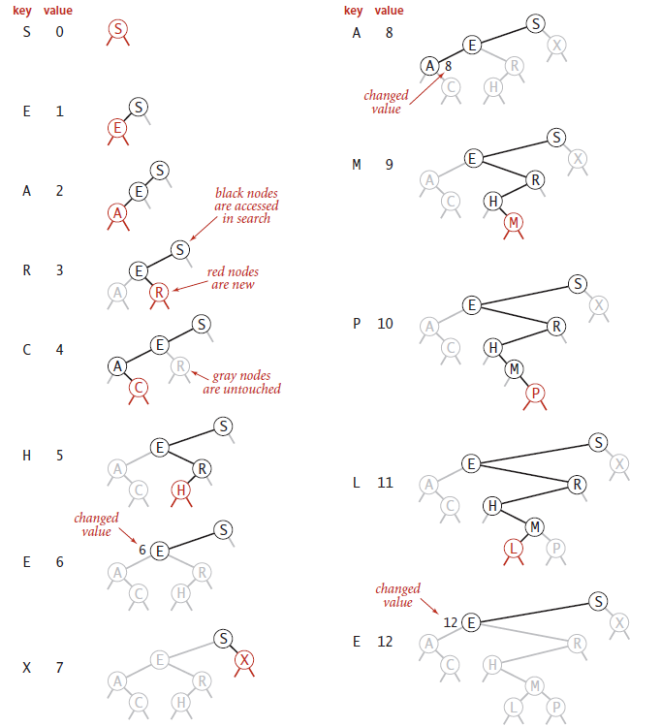

Slide 12
count

Slide 13
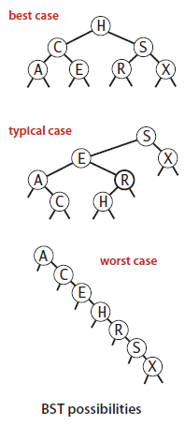
In the best case, a tree with N nodes could be perfectly balanced, with ~ logN nodes between the root and each null link.
In the worst case there could be N nodes on the search path.
Note: Does it resemble quick sort in any way?

Slide 14
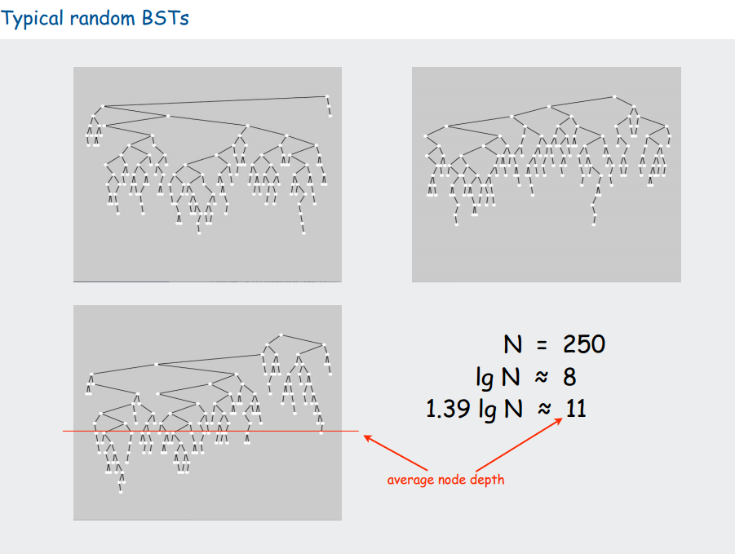

Slide 15
Traversal
Inorder traversal

Slide 16
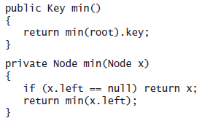
How to find Min and Max?
Min = left most?
Max = right most?

Slide 17
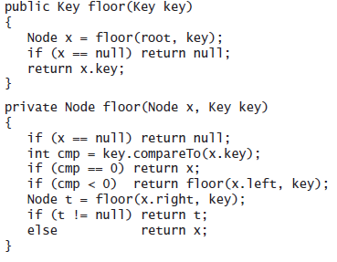
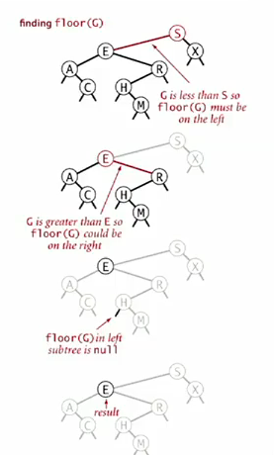
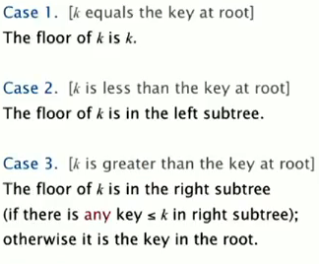
How to find floor of a number

Slide 18
Delete
Lazy delete.
Keep the key in the tree but set its value to null.
Delete the min?
Go left until finding a node that has a null left link.
Replace the link to that node by its right link. (Also update the count)

Slide 19
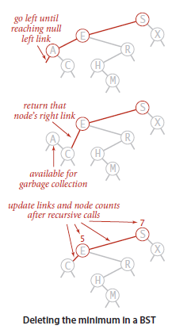
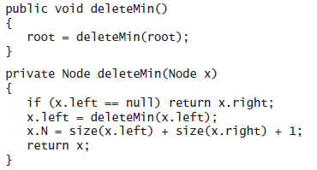
Deleting the minimum

Slide 20
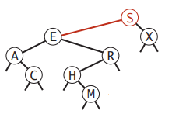
Deletion
Hibbard deletion (Hibbard is the name of the person who proposed it).
Easiest case, delete required for a node which has no children.
Set this node to null and update the rest of the tree
Delete M

Slide 21
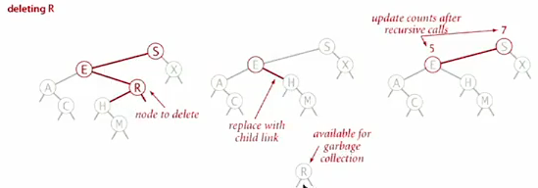
If node to delete has one child

Slide 22
Deleting a node with two children
Let’s call the node which we want to delete ‘t’.
Save a link to the node to be deleted in t.
Set x to point to its successor min(t.right).
Set the right link of x (which is supposed to point to the BST containing all the keys larger than x.key) to deleteMin(t.right), the link to the BST containing all the keys that are larger than x.key after the deletion.
Set the left link of x (which was null) to t.left (all the keys that are less than both the deleted key and its successor).

Slide 23
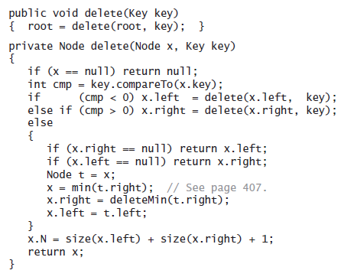

Slide 24
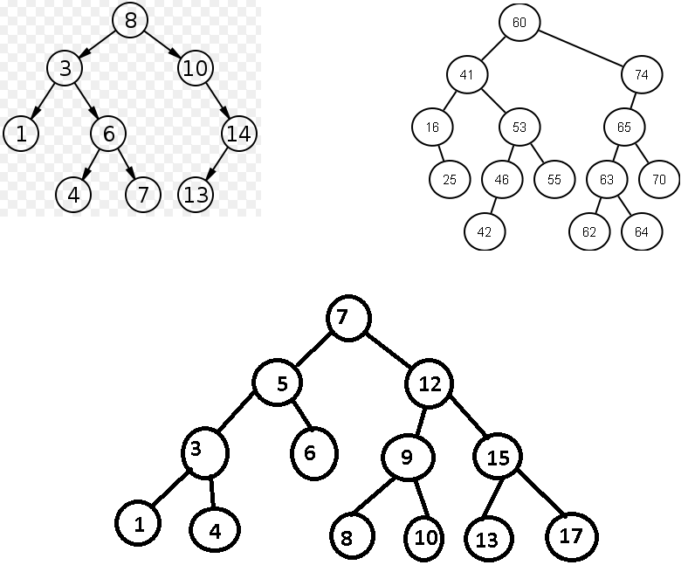

Slide 25
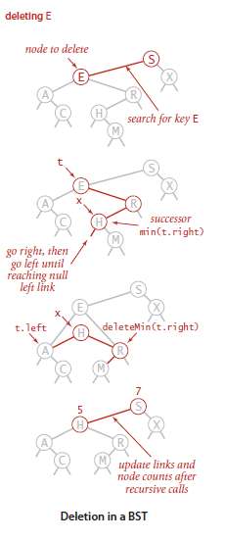
Save a link to the node to be deleted in t.
Set x to point to its successor min(t.right).
Set the right link of x to deleteMin(t.right).
Set the left link of x to t.left.
STEP 4
deleteMin(R)
Call deleteMin again with deleteMin(H)
H.left is null, so return H.right, so R.left will become H.right
Return R as right link of H

Slide 26
Pointer to E
S
Pointer to X
We need to delete E, so we call it ‘t’
x = min(t.right) => In this case, x would be ‘H’
Now the restructuring begins
t
Pointer to A
E
Pointer to R
Pointer to null
X
Pointer to null
Pointer to null
A
Pointer to C
Pointer to H
R
Pointer to null
x
Pointer to null
H
Pointer to M
Pointer to null
M
Pointer to null
3
deleteMin(R)
Call deleteMin again with deleteMin(H)
H.left is null, so return H.right, so R.left will become H.right
Return R as right link of H
4
Pointer to null
H
Pointer to R
Pointer to A
H
Pointer to M

Slide 27
deleteMin(R)
If(R.left == null) return R.right
R.left = deleteMin(R.left)
deleteMin(H)
If(H.left == null) return H.right

Slide 28
While this method does the job, it has a flaw (it unbalances the trees) that might cause performance problems in some practical situations. The problem is that the choice of using the successor is arbitrary and not symmetric.
Open problem: To find a simple and efficient delete for BST.

Slide 29
References
http://www.cs.swarthmore.edu/~newhall/unixhelp/Java_bst.pdf

